Slide 1
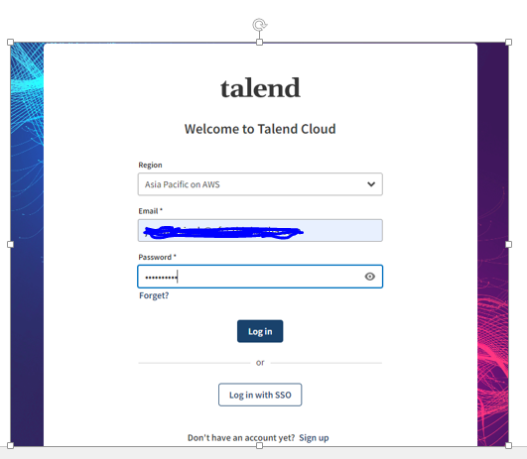
Installation of TDP & TDS on linux server
# Take the access of Talend cloud
Username:-
Password:-
#search Talend cloud on chrome
Check the specific region
Give the correct email and password
#login into Talend cloud.

Slide 2
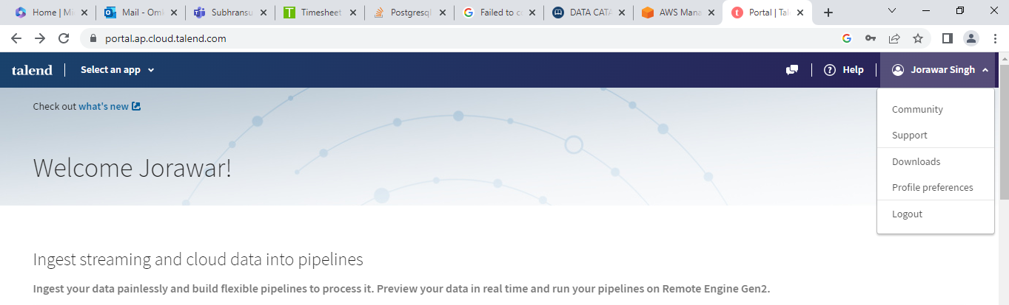
#click on the email
#Go to Download

Slide 3
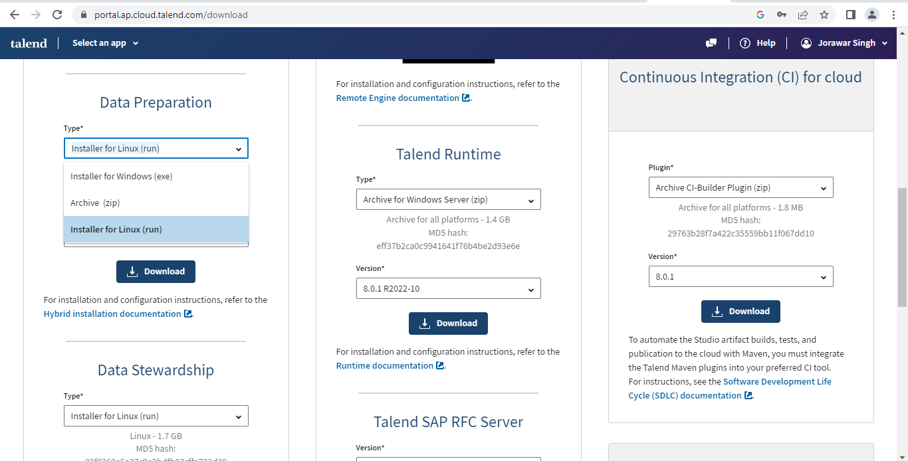
#check the Data stewardship and Data preparation.
# change the type
Installer for Linux (run)
#Click on download and Downloads the TDP & TDS

Slide 4
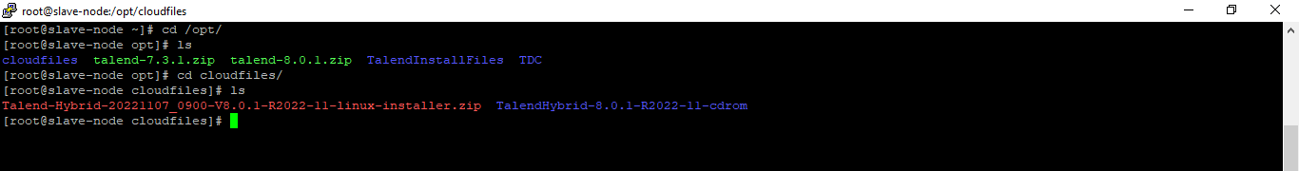
#Check the zip file has been downloaded
Talend-Hybrid-20221107_0900-V8.0.1-R2022-11-linux-installer.zip
#copy this .zip file to the linux server
i)Copy the file using winSCP
Or
ii)Open the windows powershell and go to file directory and run the command.
scp –i localhost .zipfile ubuntu@192.168.1.222:
#goto the linux terminal
mkdir Talendfiles
#copy the .zip file into directory
cp Talend-Hybrid-20221107_0900-V8.0.1-R2022-11-linux-installer.zip /opt/Talendfiles
Yum install unzip
unzip Talend-Hybrid-20221107_0900-V8.0.1-R2022-11-linux-installer.zip

Slide 5
#Install compatible java version
cd /usr/lib
mkdir jvm
chmod -R 777 jvm
wget https://www.oracle.com/in/java/technologies/javase/jdk11-archive-downloads.html#license-lightbox
#extract the java file
tar -xvf jdk-11.0.17-linux-x64.tar.gz
#set the java path
cd /etc/profile.d
sudo vi jdk.sh
export JAVA_HOME=/usr/lib/jvm/jdk-11.0.18
export JRE_HOME=//usr/lib/jvm/jdk-11.0.18/jre (if jre is not in bin then remove the line)
export PATH=$JAVA_HOME/bin:$JRE_HOME/bin:$PATH
#reboot or restart the server to check java version
java –version

Slide 6
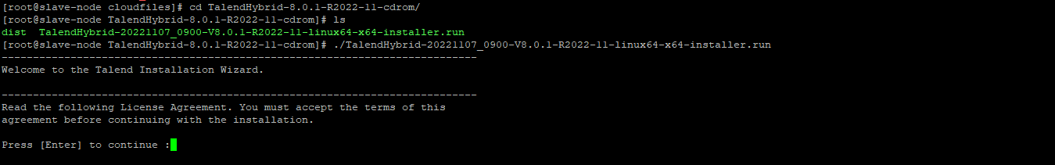
cd /opt/Talendfiles/ TalendHybrid-8.0.1-R2022-11-cdrom
./TalendHybrid-20221107_0900-V8.0.1-R2022-11-linux64-x64-installer.run

Slide 7
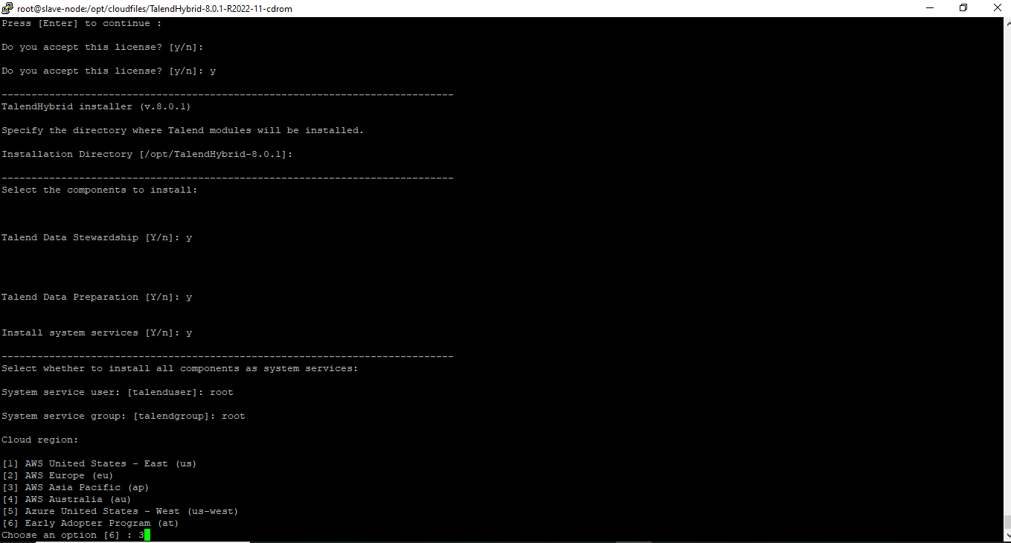

Slide 8
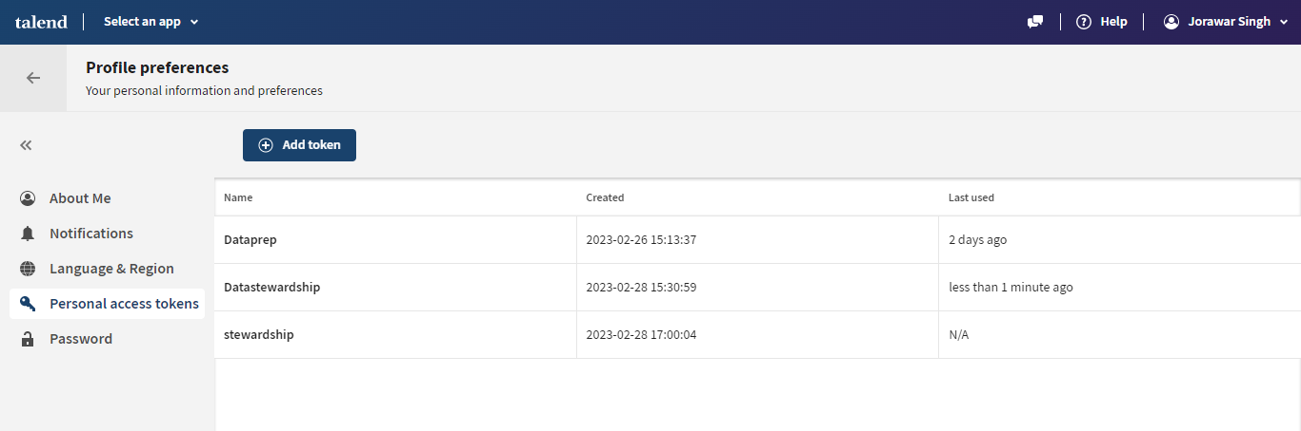
# Goto Talend cloud login
i)click on user
ii)Profile preferences
iii)Personal Access token
Generate the new token (or) Take the name of generated token.
Personal Access Token []: lOzHce8ESKe3ToHPsVhtsj-qc4ohHCJqiWtM5QKmftkcTNdlhrzcMLuBHjZhro0G

Slide 9
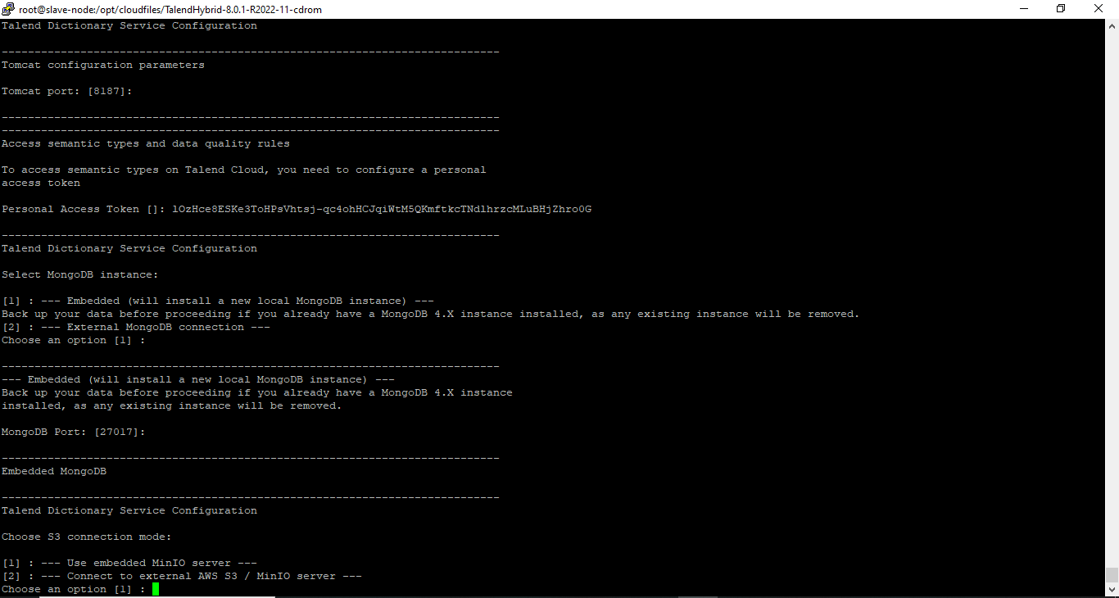

Slide 10
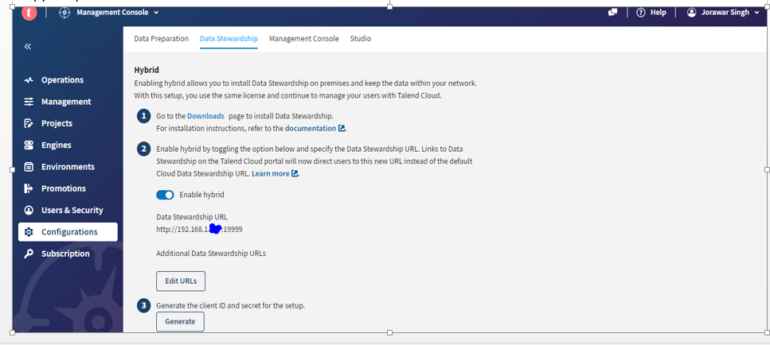
#Generate the client ID and Client Secret on Talend cloud for Data setwardship
i)Select an app
ii)Talend management console
iii)Configuration
iv)Data stewardship
v)Edit url and give the ip address
vi) Generate
Copy and paste the client ID and client secret

Slide 11
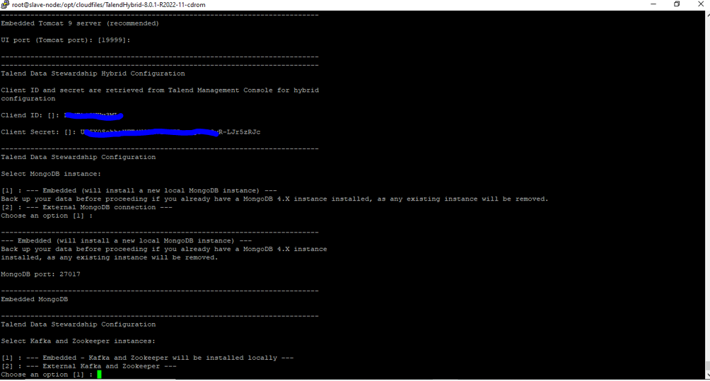

Slide 12
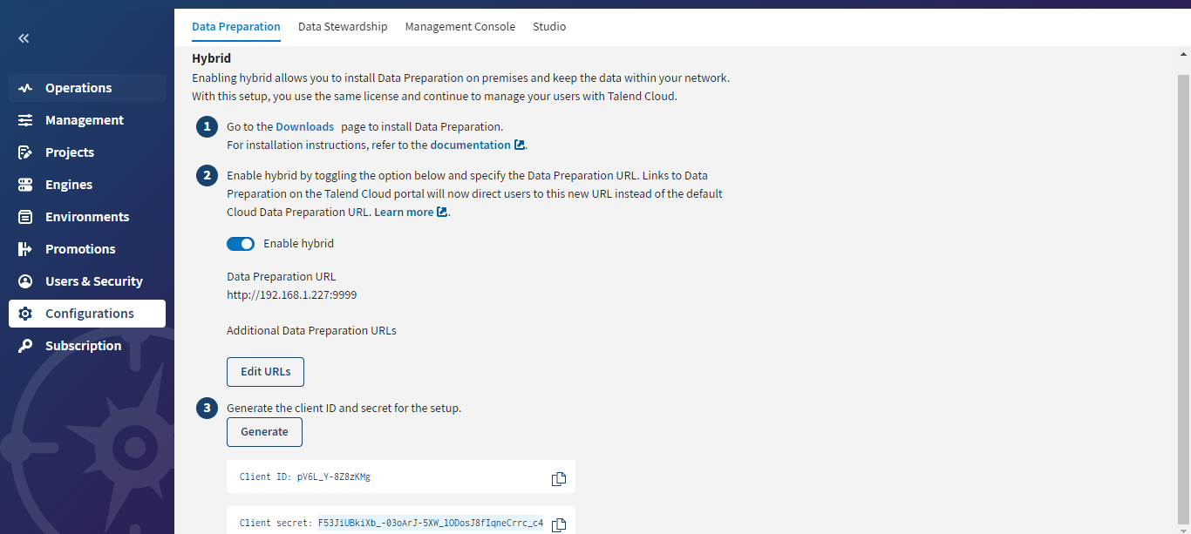
#Generate the client ID and Client Secret on Talend cloud for Data prepration
i)Select an app
ii)Talend management console
iii)Configuration
iv)Data stewardship
v)Edit url and give the ip address
vi) Generate
Copy and paste the client ID and client secret

Slide 13
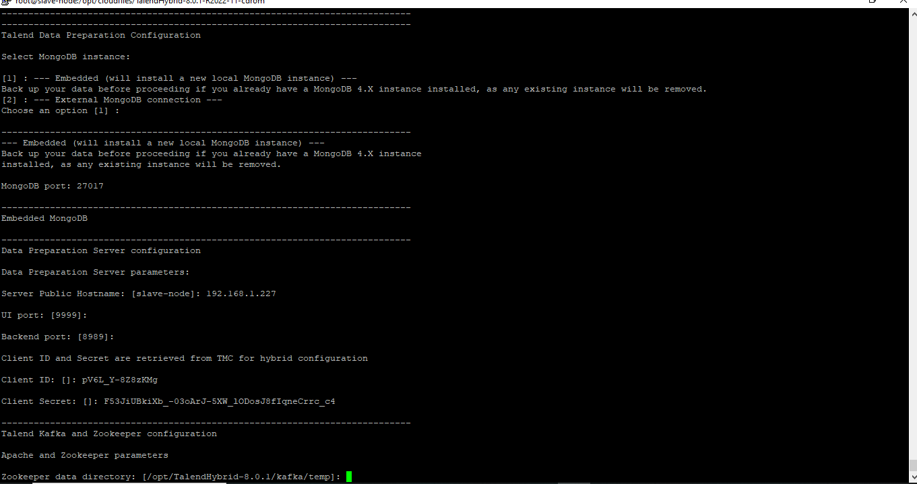

Slide 14
